Slide 1
Muffins

Slide 2
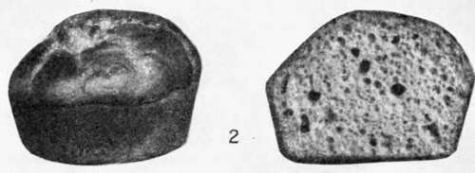
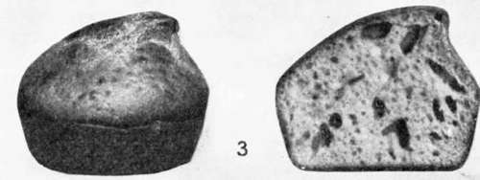
Tunnels
Over mixing
Undermixing

Slide 3
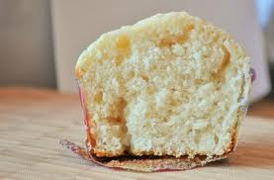
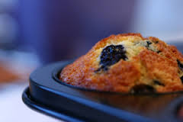
Perfect muffin
The top of the baked muffin is rough, though it browns well and is a little shiny and has a glaze.
The volume of the muffins is good
The muffin is tender

Slide 4
Over mixing
The top of the muffin is less rounded and may come to a sharp point or peak
Its crust is smoother
browns less
becomes duller in appearance with less glaze
Large holes are often found in muffins and cakes, caused by addition of air in mixing, but tunnels are long and rather narrow. When tunnels develop the muffins are less tender.

