Slide 1
Food and Nutrition 2
State Test Review

Slide 2
Kitchen Equipment
Bread knife
Serrated edge for cutting bread
Colander
Drains liquids; has larger holes than a strainer
Cutting board
Protects counter when cutting and chopping foods
For proper sanitation should be plastic instead of wood
French/chef’s knife
Large triangular blade, wide at handle and narrow at the tip
Used for slicing, cutting, chopping and dicing

Slide 3
Glass baking dish
Reduce temperature in oven 25 degrees
Ladle
Small bowl at the end of a long handle
Used for dipping hot liquid from a pan
Meat thermometer
Measures internal temperature of meat and poultry
Oven thermometer
Measures internal temperature of ovens
Pancake turner
Used to lift and turn flat foods such as hamburgers and pancakes
Pastry blender
To cut in shortening

Slide 4
Paring knife
To cut or peel small food items
Refrigerator/freezer thermometer
Used to measure internal temperature of refrigerator/freezer
Rubber scraper
Has a rubber end
Used to scrape out food from bowls, measuring cups, etc.
Slotted spoon
Spoon with holes
Used to take solids out of liquids
Straight edge/metal spatula
Long flat spatula with a straight edge
Used for leveling and frosting cakes

Slide 5
Strainer
Wire mesh that separates liquid from food
Usually has small size holes
Tongs
Used to grip and lift hot foods
Vegetable peeler
A tool used to take off the outer surface of vegetables and fruit
Wire whisk/whip
Used for blending, mixing, stirring, beating and whipping milk and eggs

Slide 6
Safety Guidelines and Safe Work Habits
Electrical appliances:
Use dry hands, stand on dry floor, keep away from water
Knives:
Dull knives are more dangerous and less efficient
Grease Fires:
Cover with lid, baking soda or salt,
Avoid flour or sugar or water
Poisonings and contamination:
Do not mix chlorine with ammonia products
Store cleaning supplies away from foods
Burns:
Lift lids on hot foods away from you
Saucepan handles point away from the front of the range
Falls:
Clean spills immediately to avoid falls
Use stepping stool to reach items in high cupboards

Slide 7
First Aid
Cuts and Burns
1. Severely bleeding – apply direct pressure
2. first-degree burn – place under cold,
running water
Electrical Shock
1. Use dry hands to disconnect power source
2. disconnect power source before approaching
injured person

Slide 8
Sanitation Standards
Hand Washing:
Wash with soap & water 20 seconds minimum
Wash after sneezing, using the restroom, coughing or touching the face, and touching raw meat
Wear gloves when cut on hand or open sores are present
Work Surfaces:
Disinfect work surfaces with disinfectant
Clothing
Change dirty aprons often
Tasting Foods
Use clean spoon and use only once
Pests and insects
Avoid crumbs or spills
Keep staples in airtight container
Dispose of garbage properly
Dish Washing Order
Rinse and scrape first
glassware before silverware
Wash pots and pans last

Slide 9
Food-Borne Illness:
Result from eating contaminated foods containing poisonous toxins
General conditions for bacteria growth:
Warmth, moisture, food
Food with food-borne illness:
Not always off-odor or off-flavor
Often look and smell normal
*Throw out off odor food!

Slide 10
Types
Botulism:
Improperly canned foods
High in low-acid foods
E-coli:
Bacteria from air from soil, fecal matter, undercooked ground beef, unpasteurized milk products & apple juice/cider
Hepatitis:
Toxin from fecal bacteria transferred by human contact through improper hand washing
Salmonella:
Found in fresh poultry and raw eggs
Staphylococci:
Spread through human mucus contact through food sources

Slide 11
Prevention
Preparation:
Proper hand washing
Washing cutting boards with soap and hot water
Storage
Store raw meat, poultry in refrigerator so they do not drip or touch other foods
Never place cooked food on plates that held raw food

Slide 12
Temperature Zones
Danger zone:
Between 41-135 °F.
Keep hot foods hot, and cold foods cold
Foods should not be left at danger zone for more than 2 hours
Cooking:
Cook to proper temperatures
ALL Ground meat - 160°F
Egg yolks and whites cooked until firm
Seafood, beef, veal, lamb - 145°F
Pork 160°F
All Poultry - 165°F
Cooling foods:
Place food in shallow dishes and refrigerate immediately
Reheating foods:
Bring sauces, soups, to a boil when reheating; heat other leftovers to 165°F
Thawing Foods:
Refrigerator is the safest way to thaw food

Slide 13
ABBREVIATIONS
Tablespoon = T, Tbs, or
Tbsp.
Teaspoon = t. or tsp
Gallons = gal.
Pound = lb. or #
Cup = c.
Quart = qt.
Ounce = oz.
Pint = pt.
Temperature = temp.
Minute = min.
Calorie = cal.
Hour = hr.

Slide 14
EQUIVALENTS
3t = 1 T
4T = ¼ cup
2 c = 1 pt
4 qt = 1 gal
16 c = 1 gal
1/8 c = 2 T
4 c = 1 qt
2 pt = 1 qt
1/3 c = 5 1/3 T
½ c = 8 T
1 c = 16 T
¾ c = 12 T
60 min = 1 hr
8 fl oz = 1 c
½ c = 1 cube butter

Slide 15
DOUBLING AND CUTTING RECIPES
Cooking temperature remains the same
The amount of ingredients changes
Length of cooking time changes
Size of pan will be affected

Slide 16
Food Preparation Terms:
Chop: Cut into small pieces
Cream: to work sugar and fat together until the mixture is soft and fluffy
*Cut in: to cut fat into flour with a pastry blender or two knives
Dice: to cut into very small cubes
Flour: to sprinkle or coat with a powdered substance, often with crumbs or seasonings
Fold in: to mix ingredients by gently turning one part over another
*Grate: to finely divide food in various sizes by rubbing it on surface with sharp projections

Slide 17
*Knead: to work dough to further mix the ingredients and develop the gluten
Mince: to cut or chop food as finely as possible
Peel: to remove or strip off the skin or rind of some fruits and vegetables
Sauté: to brown or cook foods with a small amount of fat using low to medium heat
Simmer: to cook just below the boiling point
Steam: to cook by the vapor produced when water is heated to the boiling point
Whip: to beat rapidly to introduce air bubbles into food

Slide 18
DIETARY GUIDELINES
1. Eat Nutrient Dense Foods
2. Balance calories to manage weight
3. Reduce sodium, fats, added sugars, refined grains & alcohol
4. Increase vegetables, fruits, whole grains, milk, seafood and use oil instead of fat
5. Build healthy eating patterns that meet nutritional needs over time at an appropriate calorie level.
6. Include physical exercise as part of healthy eating patterns

Slide 19
Function and Implementation of Choose MyPlate
Improves general health
Grouped according to nutrients
Groups cannot replace one another
Calories are according to age, gender, body size, and activity level
*No one food contributes all the nutrients you need.

Slide 20
Empty Calories vs Nutrient Dense
*Discretionary Calories – calories to be used on higher calorie/fat foods. For example – whole milk, candy, soda, etc
Empty Calories – relatively high calorie foods with little to no nutritional value
Nutrient Dense – relatively low in calorie foods that contribute (lots of) nutrients. *For example: Fruits, vegetables, lean meats and milk products, legumes, whole grains

Slide 21
My Plate
Bread, cereal, rice and pasta:
6 oz daily
Supply complex carbohydrates, fiber, B vitamins, and incomplete proteins
Grains should be largest portion of your diet
1 slice of bread = 1 oz

Slide 22
Fruits Vegetables
2 Cups
Provides complex carbohydrates
low in fat & sodium
High in fiber
Vitamin C & potassium
2 ½ Cups daily
Provides:
Fiber
Complex carbohydrates
Low in fat
Vitamins A, D, E, K

Slide 23
Milk, Yogurt, Cheese
Servings: At least 3 Cups
Youth to 24yrs and breast feeding women need to consume 4 servings daily
High in complete proteins, and fortified with vitamin A and D
Excellent source of calcium, phosphorus, and riboflavin
Low fat choices include: Skim milk, nonfat yogurt, low-fat cheeses
Necessary for maintaining and growing healthy teeth and bones

Slide 24
Meat, poultry, fish, dry beans, eggs and nuts
5.5 oz. daily
Provide complete proteins, B vitamins, and minerals including iron
Select lean meats, fish, poultry without skin to reduce fat
Dry beans, split peas, refried beans, pork and beans, chili and lentils are high in fiber
Nuts are higher in fat protein
Serving size:
1 oz cooked lean meat
3 oz is the size of deck of cards
½ C dried beans and peas = 2 oz
1 oz nuts = 2 oz

Slide 25
Knife Skills - Basic Safety
Walking with a knife- always walk with the knife at your side point down, carry the knife loose
Safety Terms- when walking with a knife state “sharp” to let others know you have a knife in hand
Never try to catch a falling knife
Do not place knives in the sink
Say “Behind” when walking behind or around any one handling a knife
State “hot stuff” when moving with pots or hot pans

Slide 26
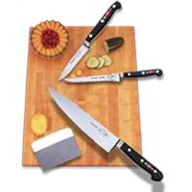
Cutting Board Set
Cutting Board- must always be stable to stabilize place a damp paper towel or dish mat
Product Pans- have pans for your product to move efficiently and cleanly, always have a place for the raw product, scraps (usable waste, waste and usable product)
Sanitation Bucket- sanitation buckets are red and should be half filled with sanitation solution

Slide 27
Knife Identifications
Chef's Knife No kitchen should be without this manual food processor. It is the most essential of all knives used in the kitchen. Slicing, mincing, dicing of all kind of food. Perfectly balanced, an extension of your hand.
Paring Knife The straight edge offers close control for decorating as well as peeling, mincing and dicing.

Slide 28
Required Cuts
Brunoise 1/8 x 1/8 x 1/8
Small Dice 1/4 x 1/4 x 1/4
Medium Dice 1/2 x 1/2 x 1/2
Julienne 1/8 x 1/8 x 1 – 2 inches
Batonnet 1/4 x 1/4 x 2 – 2 ½ inches
Diagonal Oval shaped slices, knife held on angle
Chiffonade “ribbon cut” for herbs & leafy greens

Slide 29
Brunoise
Step 1 - Prepare the vegetable as you would for julienne, making sure the
the sides are straight making it easier to produce even cuts.
Step 2 - Slice the vegetable length wise into 1/8 inch slices using a series of parallel cuts.
Step 3 - Cut each slice into baton shapes 1/8 inch wide.
Step 4 - Using a series of parallel cuts, cut the batons into 1/8 inch cubes.

Slide 30
Macedoine – Small Dice
Step 1 - Prepare the vegetable as you would for batonnet.
Step 2 - Trim the vegetable so that the sides are straight, making it easier to produce even cuts.
Step 3 - Slice the vegetable length wise into ¼ inch slices using a series of parallel cuts.
Step 4 - Cut each slice into baton shapes ¼ inch wide.
Step 5 - Using a series of parallel cuts, cut the batons into ¼ inch cubes.

Slide 31
Julienne
Step 1 - Trim the vegetable so that the sides are straight, making it easier to produce even cuts.
Step 2 - Slice the vegetable length wise to the desired thickness using parallel cuts.
Step 3 - Stack the slices and make even parallel cuts to produce a series of batons.
Step 4 - The finished result is a series of batons 1/8 inch x 1/8 inch x 1-2 inches

Slide 32
Batonnet
Step 1 - Peel the vegetable using a peeler of paring knife.
Step 2. Top and tail the vegetable by removing the ends.
Step 3 - Cut the vegetable into sections approximately 2- 2 ½ inches long.
Step 4 - Trim the vegetable so that the sides are straight, making it easier to produce even cuts.
Step 5 - Slice the vegetable lengthwise to parallel ¼ inch cuts
Step 6 - Cut each slice into baton shapes about ¼ inch wide

Slide 33
Chiffonade
Step 1 - Wash and drain the vegetable well.
Step 2 - Carefully remove any stalks.
Step 3 - Slice the cylinders of leaves crosswise into thin strips.
Step 4 - Stack and roll the leaves into a cylinder.

Slide 34
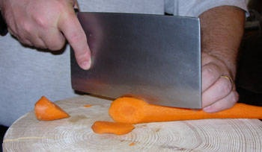
Diagonal
Oval shaped slices, knife held on angle
Properly hold the knife and food securely.
Place knife at an angle
Slice through

Slide 35
Small Appliances
1) Stand Mixers - sturdy and hardworking – more powerful than a hand mixer
2) Food Processor - The bowl capacity is large, cuts, blends, mixes, shreds, etc
3) Blenders - workhorse in the kitchen. Use it to make salad dressings, blend bisque soups, and make milkshakes for the kids in summer.
4) Immersion blenders – Handheld “blenders”. They are at the end of a stick so you can submerse it in the liquid.

Slide 36
Thermometer Calibration
Ice Point Method
►Fill an insulated cup with crushed ice and water. ►The cup must have enough crushed ice to provide an environment of 32°F, so you may need to pack more ice into the cup during the process. ► When the mixture of the water has stabilized in about four or five minutes, insert the thermometer to be calibrated to the appropriate immersion depth. ►Be sure to hold the stem of the instrument away from the bottom and sides of the container (preferably one inch) to avoid error.
► If your thermometer is not accurate within +/- 2°F of 32°F., adjust the thermometer accordingly. The ice point method permits calibration to within 0.1°F.
Boiling Point Method
► Place distilled water in a container and heat. ► After the water in the container has reached a complete “rolling” boil, insert the instrument to the appropriate immersion depth. ► Be sure there is at least a two-inch clearance between the stem or sensing element and the bottom and sides of the container. ► If your thermometer is not accurate within +/- 2°F of 212°F., adjust thermometer accordingly. The boiling point method permits calibration to within 1.0°F.

Slide 37
Fiber
20-35 grams daily
Roughage
Attracts water to our intestines, and moves food through the intestines faster
Keeps bowel movements soft, reduces constipation
Cellulose = nondigestible fiber
Food high in fiber: fruits, vegetables, whole grains, legumes, bran cereal, dry beans
Reduces risk of diverticulosis, colon & rectal cancer
To add fiber to a recipe add: bananas, berries, replace flour with part whole wheat flour

Slide 38
EXERCISE
Important throughout the life cycle
Improves self-esteem and feelings of well-being
Increases fitness level
Helps build and maintain bones, muscles, and joints
Builds endurance and muscle strength
*To lose weight you need to decrease calories & increase exercise – up to 2 lbs a week weight loss is safe

Slide 39
Exercise cont.
Enhances flexibility and posture
Helps manage weight
Lowers risk of heart disease, colon cancer, and type 2 diabetes
Helps control blood pressure
Reduces feelings of depression and anxiety
*The most important nutrient to replace after exercising is WATER

Slide 40
Proper Nutrition Helps:
Body resist disease
Recuperation
Supply energy

Slide 41
Childhood Nutrition
Children have very small stomachs that cannot hold very much food at one time.
Therefore, they need between-meal snacks to help supply enough energy and nutrients.
*Nutrient dense snacks could include: *juice, yogurt, milk, fruit, vegetables, cooked meat, unsweetened cereal, whole grain crackers
*Kids like bright colored finger foods.

Slide 42
Prenatal Nutrition
Proper development during the prenatal period depends on the right nutrients. This responsibility falls on the mother.
The major nutrients that a mother needs during pregnancy are:
a. Protein b. Iron c. Calcium d. Folic Acid
*Pregnant women need folic acid within the first 28 days to help prevent neural tube defects, such as spina bifida.

Slide 43
Teen Nutrition
Follow the recommended number of servings on the new food guide pyramid.
Adolescence is a time of great activity and RAPID growth.
Adolescent need a variety of nutritious foods throughout the day.
Teens should avoid high sugar and high fat snack foods and monitor amounts of caffeine and carbonated drinks.

Slide 44
Teen Athletes
Three nutrients needed to provide energy are: Carbohydrates, Protein and Fat
Muscle is built by exercise, NOT by eating extra protein.
Nutrient-dense foods are required because of high-energy output
Meals should be eaten 3-5 hours before an athletic event.
Water is ESSENTIAL--2 cups of water is recommended for every pound lost during a workout.
Potassium replacement is recommended after a workout. A good way to accomplish this is by eating dried fruit, fruit, vegetables, and drink low-fat milk.

Slide 45
Adult Nutrition
Metabolism slows down; generally total food intake needs to be reduced
*Metabolism: chemical process in the body that provide energy in useful forms to sustain vital activities
Exercise is an important component to balancing food intake and output.
Sedentary lifestyle creates a greater need for daily exercise.

Slide 46
The Aging and The Elderly
Nutrient dense foods are important.
*Taste sensations and smells are less sensitive.
Low sodium and low-fat diets are common.
Various physical and mental challenges may limit ability to purchase and prepare foods.
Elderly who live alone have a harder time eating a variety of nutritious foods; malnutrition is a concern.
Many health concerns and diseases incident to aging effect eating habits and food choices.

Slide 47
Anemia
Cause - There is a severe depletion of iron stores resulting in low blood hemoglobin
Prevention-Meat is an excellent source of iron
Not all ingested iron is absorbed; vitamin C helps to absorb iron when taken together.
Fortified cereals have iron added

Slide 48
Colon Cancer
Causes
Hereditary
Not enough fiber in
the diet.
Prevention
Diets should consist of 20 - 35 grams of fiber a day
Fiber helps food move through large intestine
Good sources of fiber include fruits, whole grains, vegetables
Insoluble fiber significantly inhibits the development of precancerous colon and rectal polyps

Slide 49
Diabetes - Causes
Causes
Diabetes affects the body’s production and use of insulin - making blood glucose levels abnormally high
Insulin is a hormone produced in the body.
Type 1 – child/juvenile
Type 2 – adult onset

Slide 50
Diabetes – Prevention
Maintaining a healthy body weight helps to prevent hyperglycemia
Soluble fiber may improve the control of blood sugar and can reduce the need for insulin or medication
Important to manage carbohydrate intake through diet and/or receiving insulin

Slide 51
Coronary Heart Disease (CHD) – Causes
Plaque forms along the inner walls of the arteries - arteriosclerosis
Saturated fat in the diet is changed to cholesterol which forms the plaque

Slide 52
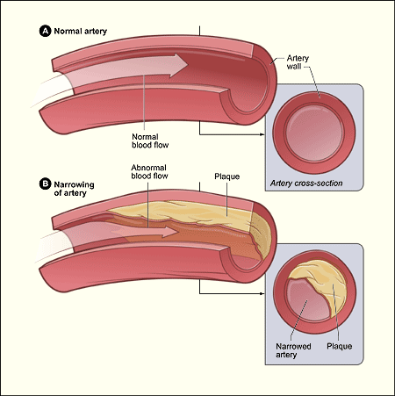
Coronary Heart Disease (CHD) – Prevention
*Decrease consumption of foods high in saturated fats and sodium
High sodium/salt foods - onion rings, pickles, french fries, potato chips, some soft drinks

Slide 53
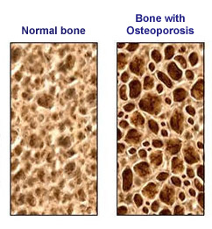
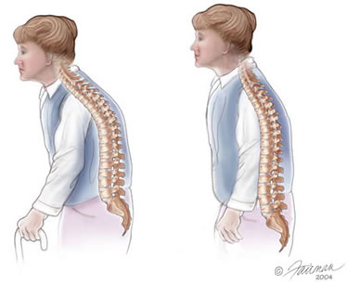
Osteoporosis – Causes
Bones become porous and fragile due to the lack of calcium
Bone density is developed during the first 25 years of life. After age 25, calcium consumption helps to maintain the existing bone density

Slide 54
Osteoporosis – Prevention
Recommended daily fluid milk intake
children - 4 cups
adolescents - 4 cups
adults - 3 cups
MyPlate recommends at least 3 cups

Slide 55
Obesity - Causes
Obesity occurs when a person consumes more calories than he or she burns. For many people this boils down to eating too much and exercising too little.
If your BMI is 30 or greater, you're considered obese.
Fat deposited primarily around your middle increases your risk of many of the serious conditions associated with obesity. Women's waist measurement should fall below 35 inches. Men's should be less than 40 inches.

Slide 56
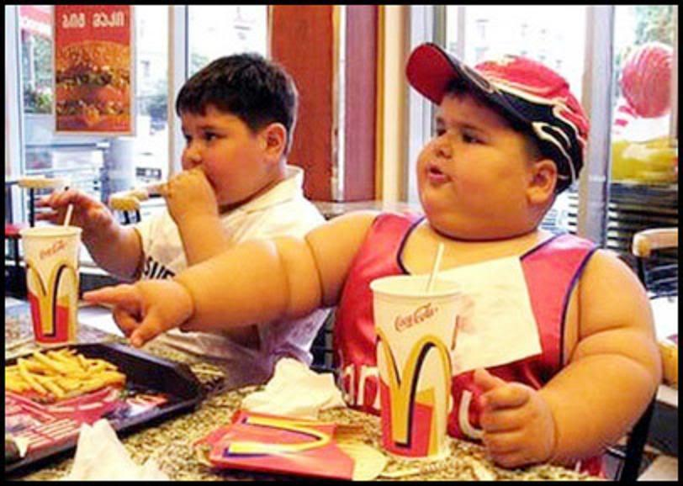
Obesity - Risks
Overweight and obese individuals are at increased risk for many diseases and health chronic conditions, including the following:
Hypertension (high blood pressure)
Osteoarthritis (a degeneration of cartilage and its underlying bone within a joint)
Dyslipidemia (for example, high total cholesterol or high levels of triglycerides)
Type 2 diabetes
Heart disease
Stroke
Gallbladder disease
Sleep apnea and respiratory problems
Some cancers (pancreas, kidney, prostate, endometrial, breast, colon)

Slide 57
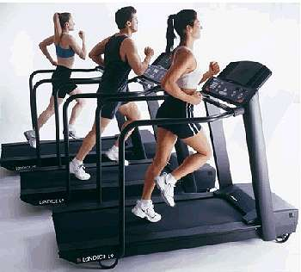
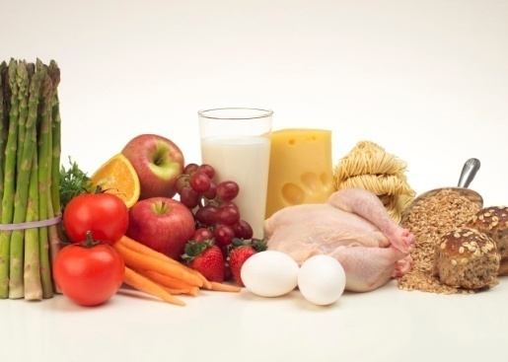
Obesity Prevention
Regular exercise and a healthy diet are crucial when it comes to controlling your weight. Although there are many programs advertised to help you lose weight, the only method proven safe over the long-term is to burn more calories than you consume.

Slide 58
A Good Meal Includes…
Following the food pyramid
Following the dietary guidelines
Maintaining nutritional balance
Making food look good to eat (aesthetics)

Slide 59
Remember
Texture
Color
Shape and Size
Flavor
Temperature
Preparation Method
Nutritional Variety

Slide 60
Parts of a Meal:
Appetizers:
Main dish:
Accompaniments:
Salad:
Dessert:

Slide 61
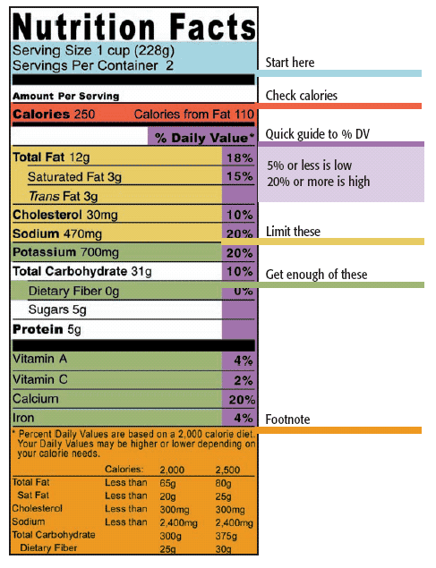
Labels - Components
Nutritional Facts
*Ingredient list in order
of amount (largest to
smallest)
Daily % of values
Serving Size
Based on a 2000
calorie diet!!

Slide 62
Low in
the food could be eaten frequently without exceeding recommended amounts
i.e. fat, saturated fat, cholesterol, sodium or calories
low in fat means that one serving has no more than 3 grams of fat

Slide 63
Reduced, less, or fewer
the food must have at least 25% less of something (fat, calories, sodium) than a comparison food
the term reduced is used when the food has been nutritionally altered

Slide 64
Good source of
one serving of the food contains 10 -19% of the daily food value for a particular nutrient

Slide 65
Organic and natural
Have not been defined by law
Generally accepted to mean free from artificial/chemical fertilizers and pesticides

Slide 66
High source of fiber
at least 20% from fiber

Slide 67
Juice
must be 100% juice
products using the terms fruit drink or fruit beverage may contain less than 10% fruit juice

Slide 68
Dates on Labels
sell date
indicates the last day the product should remain on the store shelf
allows a reasonable amount of time for home storage/use after that date
may also say “sell by (date) or best if purchased by _(date)_”
examples - dairy products, cold cuts

Slide 69
Dates on Labels cont.
use by date
recommended date to use the product by
product may still be safe to eat after the date has passed
quality will start to go down
examples - breads, cereals, dressings

Slide 70
Dates on Labels cont.
open dating
gives consumer an idea of how long a product can remain wholesome and safe
a package date doesn’t guarantee quality; that depends upon how the product was handled

Slide 71
**Convenience vs. Homemade
Convenience | Homemade
Faster | More time
More expensive | Less expensive
Higher fat/sodium | Lower fat/sodium
Less nutritious | More nutritious
Sometimes less tasty | Usually more tasty
Decreases Prep Time*
Sometimes Decreases Quality*

Slide 72
National vs. Store brand
National brands usually cost more
Store brands are often the same quality

Slide 73
*Time Management
Organize the kitchen
Assemble the ingredients and equipment before beginning (*mise en place – means to put everything in its place)
Work on several items at the same time (dove-tailing)
Clean as you go

Slide 74
Time Management cont.
Use time saving shopping strategies
Prepare larger quantities of food and freeze some for later
Use convenience foods to save time (may increase expense, and lower quality).
*The first thing you should prepare is the thing that takes the longest to cook.

Slide 75
Shopping Tips
Fruits and vegetables in season are generally at their lowest price.
Plan menu around grocery ads.
Make a weekly menu plan.
*Make a list and use it.
Create a categorized shopping list
Take a calculator
Never shop when hungry or tired
Shop alone

Slide 76
Shopping Guidelines & Advertising Strategies
Loss Leaders – get you in the store in hopes that you’ll buy more
Coupons – entice you to try something new or something you wouldn’t normally buy
*Coupons are wise IF the final cost is less than comparable and if you use it
Impulse buys – purchase something you didn’t plan on buying
Layout of store/shelf placement – put things at eye level of intended purchaser; scatter things around the store; etc

Slide 77
Unit pricing/cost per serving
price per unit - ounce, quart, pound or other unit to show the best value
*unit price = total price divided by the number of units (total price/#of units)
6 sodas are $2.99 – how much per soda?
unit pricing is often figured and listed on the store shelf
unit pricing is a way to compare brands and also different size packages/containers of the same brand
largest package isn’t always the least expensive per unit

Slide 78
Unit pricing/cost per serving cont:
larger package even if it is cheaper per unit not always best buy if the product isn’t going to be used before the expiration date or spoilage
cost per serving = total price divided by the number of servings
cost per servings is often used to compare two different types of foods
example - chicken breast with bone and skin vs. boneless skinless chicken breast

Slide 79
Table Setting
Influences the appearance of the food
Sets the tone/feeling of the meal
Makes people feel important
*At the end of the meal you should place your napkin to the left of your plate.

Slide 80
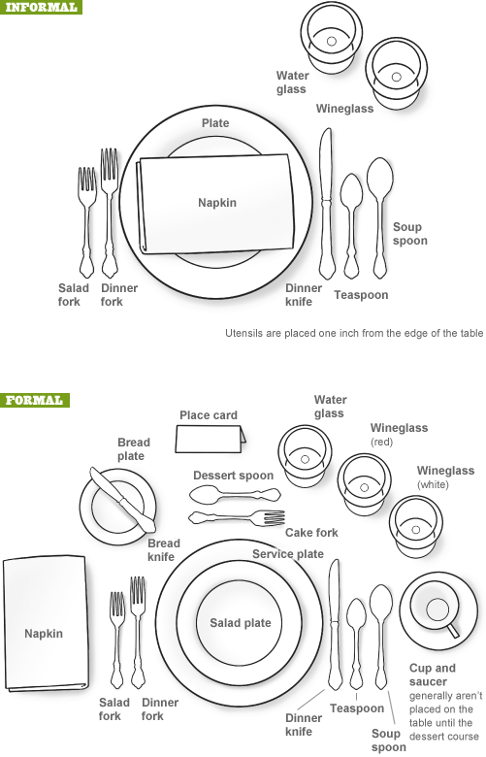

Slide 82
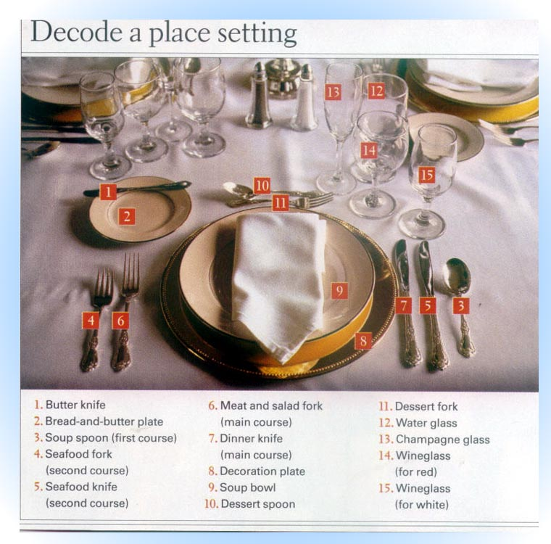

Slide 83
Dining Etiquette
Flatware use – Work from the outside in
Tipping – standard 15% (aka gratuity)
*Napkin placement – never so something has to be moved to get napkin
Cell phone – not appropriate at table. Period. If you must call/text/etc politely excuse yourself from table.
Table Manners
Passing food – generally to the right
Eating Roll – break off piece and butter it
*Cutting meat – only cut bite by bite

Slide 84
Cover
Arrangement of a place setting for one person

Slide 85
Types of Salad
Appetizer (fruit, vegetable, pasta)
Accompaniment (fruit, vegetable, pasta)
Main Dish (*protein, vegetable, pasta)
Dessert (fruit, gelatin)

Slide 86
Salad Classification
Mayonnaise based – potato salad, chicken salad, ranch dressings, etc
Vinaigrette – 3 parts oils to 1 part vinegar ratio. – balsamic vinaigrettes, raspberry, etc

Slide 87
Nutrients found in salads
Determined by foods in salad
Carbohydrates (fiber)
Pasta, potatoes,
Fats
Dressings
Protein
Meats, cheeses, eggs
Minerals & Vitamins (fiber)
Fruits, vegetables

Slide 88
Salad Making Principles
Freshness
Nutrient Value
Colorfulness
Attractiveness
Drain ingredients well
Cut into convenient eating size
Prepare right before serving

Slide 89
Soups – 2 basic types
*Stock
Liquid from cooking meat, poultry, fish or vegetables
*Examples- Chicken Noodle, Minestrone
Milk
Milk or cream is thickened
Examples – Cream of Broccoli, chowders

Slide 90
Soups
Appetizer – A small portion of food (soup) usually served at the start of a meal.
Entree – The main course of the meal.
Side – Goes along with the main course
Dessert – Final course in a meal
Dehydrated soups – have water evaporated
*Remember to store/cool soups in a shallow container

Slide 91
Mother/Leading/Grand Sauces
Sauce | Liquid | Thickener | Color
Béchamel | Milk | White roux | White
Espagnole | Brown Stock | Brown roux | Brown
Tomato | Tomatoes | Tomato paste | Red
Hollandaise | Clarified Butter | Egg yolk | Yellow
Velouté | White Stock | Blond roux | Amber
*Roux-melted fat and flour – used to thicken sauces. In a white sauce the roux is butter and flour.

Slide 92
Casseroles
A mixture of several foods baked and served in the same dish
Easy
Time Saver
Complete meal in a dish
Economical
Large variety-made ahead of time-freeze
Requires little effort during cooking process
Served in same dish it’s baked in
Leftovers easy to use

Slide 93
Food/function in Casseroles
Protein
main ingredient
fish, meat, egg, dried beans, cheese
*Carbohydrate/starch
substance/body
*Used as extender
Adds energy through carbohydrates
Undercook rice and pastas so they can continue to cook during baking process

Slide 94
Food/Functions in Casseroles cont.
Vegetables
Add contrast in color
Texture
Adds Nutrition
*Binder
Sauce - Holds ingredients together
Toppings
Used for color, variety in texture, protects protein ingredients
Examples – Potato chips, bread crumbs, crackers, etc

Slide 95
Yeast Breads
Rolls
Loaves
Deep-fat fried
Shaping – The process of forming dough into distinctive shapes associated with yeast products
*Water that is too HOT can kill yeast
* Water that is too COLD won’t activate yeast

Slide 96
Ingredients in yeast breads
flour – main ingredient, structure
liquid – provides moisture
salt – flavor, controls rate of yeast growth
yeast – leavening agent
fat – tenderness
sugar – sweetness, food for yeast, browning
Eggs – can be used as another “liquid” in bread recipes. Eggs add extra protein, color, richness, and structure (just like the gluten in flour).

Slide 97
Yeast Breads
Fermentation – The process in which yeast breaks down sugars into carbon dioxide gas and alcohol, which are necessary for the rising process in products, such as bread
Kneading - To work dough by pressing and using heel of hands to develop gluten and provide structure.
Baking/Oven Spring – The sudden rise and expansion of dough as the yeast reacts to the heat of the oven.

Slide 98
Yeast Breads - Proofing
Proofing is the final rise of shaped or panned yeast products before baking
Ensures proper volume and texture
Under proofing – poor volume and texture
Over Proofing – sour flavor, poor volume, paler color

Slide 99
Pastries
Mainly a shell to hold a filling
Ice cold water will make them more flaky
Sifted flour is lighter
Double crust - top and bottom crust
Single crust – only bottom crust
Pie Shell – bottom pie crust baked before filling
Pastries with foods that spoil (milk products. etc) should be refrigerated

Slide 100
Pastry
What are the four main ingredients in pastry, and their function?
Ingredient Function
Flour structure
Salt flavor
Fat tenderness
Liquid hold together, moisture

Slide 101
Storage & Handling of Pastries
Cream/custard pies – Refrigerate
Savory pies – refrigerate
Fruit pies – can be left on counter, covered
*Handle pastries as little as possible
Cut in fat to flour in pastries to make it a flakier more tender crust.

Slide 102
Meat - Lean Cuts
Lean
Less than (based on 3.5 oz. serving)
10 grams of fat
4 grams of saturated fat
95 milligrams of cholesterol
Appearance
Less than ¼ in. fat around meat
Beef Roasts & Steaks: round, loin, sirloin, chuck arm
Pork Roasts & Chops: tenderloin, center loin, ham
Veal Cuts: all except ground veal
Lamb Roasts & Chops: leg, loin, fore shank
Fatty cuts – trim excess fat

Slide 103
Cooking methods
High fat
Low fat
Roasting
Baking
Broiling
Steaming
Poaching
Braising
Grilling
Sauté in non-stick pan
Frying
Sautéing in large amounts of fat
Cooking with fatty sauces and gravies
Basting with fat

Slide 104
Inspection & Grading - Meat
USDA
Stamped w/ harmless vegetable dye
Meat
Graded according to:
Marbling (internal fat w/in the muscle tissues)
Age of animal
Texture and appearance of meat
Common grades of beef:
Prime
Well marbled, tender, flavorful, $$$
Choice
Most common, less marbling than prime but still tender
Select
Least amount of marbling, least expensive
Lamb & Veal
Same as beef w/ “good” replacing “select”
Pork
Not graded due to uniform quality

Slide 105
Inspecting & Grading - Poultry
USDA- United States Department of Agriculture
Grade may appear on the package or attached to the wing of the bird
Grade A, B, or C
Grade A is the most common found in supermarkets—
Practically free of defects
Good shape and appearance
Meaty

Slide 106
*Chicken-
Light meat- leaner and milder flavor; breasts and wings
Dark Meat- more oxygen in this part of meat (more myoglobin) which causes dark color; legs and thighs; higher in fat
*Use a meat thermometer by sticking the probe in the thickest part of the meat not touching any bones. Wait until temperature stabilizes to read.
*Test for safety and to make sure it is done.

Slide 107
*Dry Heat Cooking
Preparing food without adding liquid, with or without fat.
Grilling
BBQ
Broiling
Roasting
Baking
Microwaving
Sautéing
Stir-frying
Pan frying
Deep-fat-frying

Slide 108
*Moist Heat Cooking
Uses liquid or steam to cook food.
Boiling
Shallow Poach/Poach
Simmering
Blanching
Steaming

Slide 109
Combination Cooking
A combination of both dry-heat and moist-heat cooking methods.

Slide 110
Meat Cookery
Braise – moist/less tender cuts
Slow cooking – moist/less tender cuts
Broil – dry/tender cuts
Grill – dry/tender cuts
Roast – dry/tender cuts
Sauté – dry/tender cuts

Slide 111
Bone Affects Serving Size
¼ lb boneless meat/person
½ lb moderate bone meat/person
1 lb large bone (turkey)/person

Slide 112
Vocabulary
BACTERIA: living microorganisms that need food, warmth and moisture to survive.
CLEAN: free from dirt, soiled or unstained.
SANITIZE: to free from dirt, germs etc., by cleaning or sterilizing.
FIFO: First in First Out. The method of rotating food storage.
PATHOGENS: Any disease producing agent.
MISE EN PLACE: Proper planning and placement of ingredients for food preparation and assembly station. (Put in place)
YIELD: the quantity or amount produced.
BLANCH: to scald briefly and then drain.
BRAISE: to cook (meat or vegetables) by browning in fat, then simmering in a small quantity of liquid in a covered container.
BROIL: to cook by direct heat.

Slide 113
Vocabulary cont.
GRILL: a grated utensil, for broiling meat or vegetables, etc. over fire.
ROAST: to bake uncovered using dry heat.
SAUTE: cooked or browned in a pan containing a small amount of hot fat.
STIR FRYING: to cook food quickly by cutting into small pieces and stirring constantly in a lightly oiled wok or frying pan over high heat.
BECHAMEL: a white sauce made of butter, flour, milk or cream.
VELOUTE: A white sauce made with meat, poultry, or fish stock.
ESPAGNOLE: brown sauce with tomatoes and a caramelized mixture of minced carrots and onions.
TOMATO: Sauce made with pureed tomatoes with savory vegetables and other seasonings.
HOLLANDAISE: A sauce made from eggs and butter with lemon juice.
MIREPOIX: A flavoring made of diced vegetables, seasonings, herbs, and sometimes meat, often placed in a pan to cook with meat or fish.

Slide 114
Vocabulary cont.
STOCK: Simmering ingredients together such as: meat, bones, vegetables and spices/herbs.
CARAMELIZATION: To convert or be converted into caramel
AL DENTE: Cooked so as to not be too soft; firm to the bite.
LEGUMES: Dried beans and peas.
CROSS-CONTAMINATION: Spread of harmful bacteria from one food to another.
DANGER ZONE: 41-135 degrees Fahrenheit—where bacteria can grow.
SALMONELLA: Bacteria that may enter the digestive tract in contaminated food and cause abdominal pains and violent diarrhea.
E-COLI: Bacteria from undercooked ground hamburger.
BOTULISM: A sometimes fatal disease of the nervous system acquired from spoiled foods in which botulism is present, especially in improper canned or marinated foods.
HEPATITIS A: an RNA virus, usually transmitted by ingestion of contaminated food or water.

Slide 115
Vocabulary cont.
STAPH: bacteria gathering in grapelike clusters usually causing boils and other infections.
FERMENTATION: A change brought by a ferment, as yeast enzymes convert sugar into ethyl alcohol.
KNEADING: To work into a uniform mixture by pressing, folding and rotating.
PROOFING: A period of leavening of dough preceding baking.
SHAPING: To create various rolls/loaves by forming the dough.
BAKING/OVEN SPRING: After the yeast bread has been baked for the first 10 minutes and the dough grows to its largest size.

Slide 116
Food and Nutrition 2
State Test Review

