Slide 1
Cream, Butter, Yogurt, Cheese, and Ice Cream

Slide 2
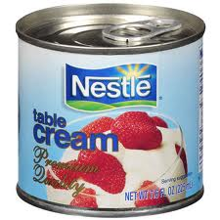
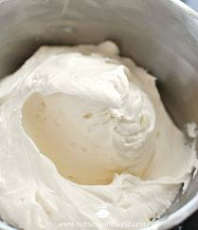
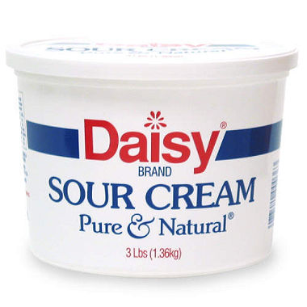
Cream
Half-and-half
18% fat, used in coffee or other beverages
Light, coffee or table cream
18-30% fat, table cream and cooking
Light whipping cream
30-36% fat, used in desserts
Heavy whipping cream
36% fat, used in desserts
Sour cream
18% fat, tangy flavor-made by adding lactic acid bacteria

Slide 3
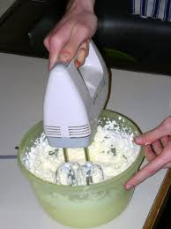
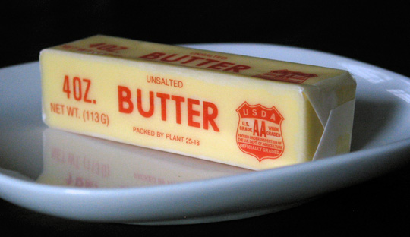
Butter
Heavy whipping cream whipped at high speed
Churning separates fat from the liquid.
80% milk fat
Grade AA, Grade A, Grade B
Salted or unsalted
Whipped Butter

Slide 4
Butter vs. Margarine
Raises Cholesterol
High in SATURATED FAT
Same amount of fat
Natural, heavy whipping cream
Raises Cholesterol
High in TRANS FAT
Same amount of fat
“vegetable shortening”, “hydrogenated”, “partially hydrogenated”

Slide 5
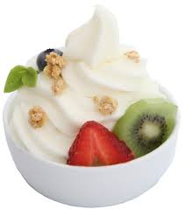
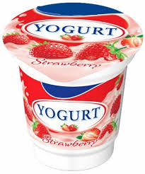
Yogurt
Adds special harmless bacteria to milk
Results in thick, creamy product
Bacteria helps keep a healthy digestion
Contains more calcium
Flavors contain added sugars (plain yogurt with fruit)

Slide 6
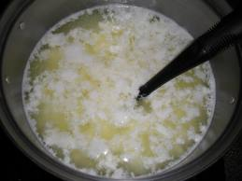
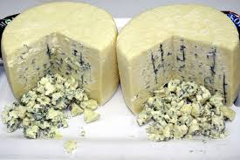
Cheese
Made from cow, goats, sheep, buffalo
Enzymes added to milk called rennin.
Fresh vs. Ripened
Cottage cheese Cheddar
Cream cheese Parmesan
Ricotta Blue cheese
Served best at room temperature

Slide 7
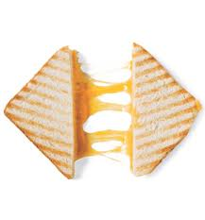
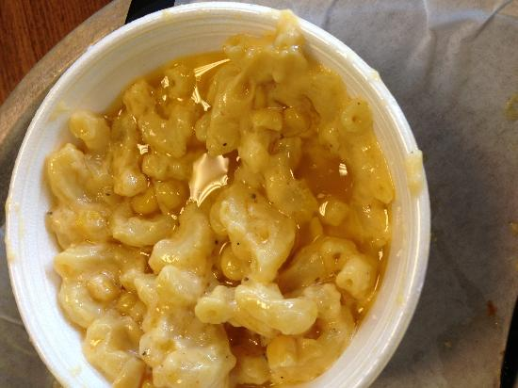
Cooking with cheese
Overcooked cheese gets tough and rubbery
If fat separates, food will have an unappetizing appearance and lack flavor
Should be cooked until it melts.
Precook other ingredients
Bread crumbs or corn flakes?

Slide 8
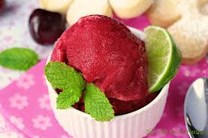
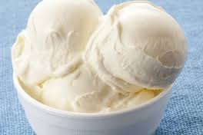
Ice Cream
Ice Cream
Cream, milk, sugar, flavors. 10% fat
Frozen Yogurt
Varies in fat depending on yogurt. Freezing destroys beneficial bacteria
Sherbet
Made from fruit or juice, sugar, water. Less fat but more sugar
Sorbet
Light dessert with sweetened fruit, juice and water NOT milk
Custard
Same as ice cream but with egg yolk, richer and creamier texture.

Slide 9
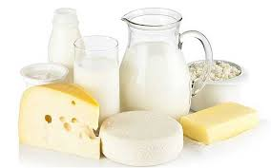
Storing Dairy Foods
Highly perishable
Keep them in original containers.
Pick up off-flavors, tight containers
Cheese can be frozen but changes texture
crumbles

