Slide 1
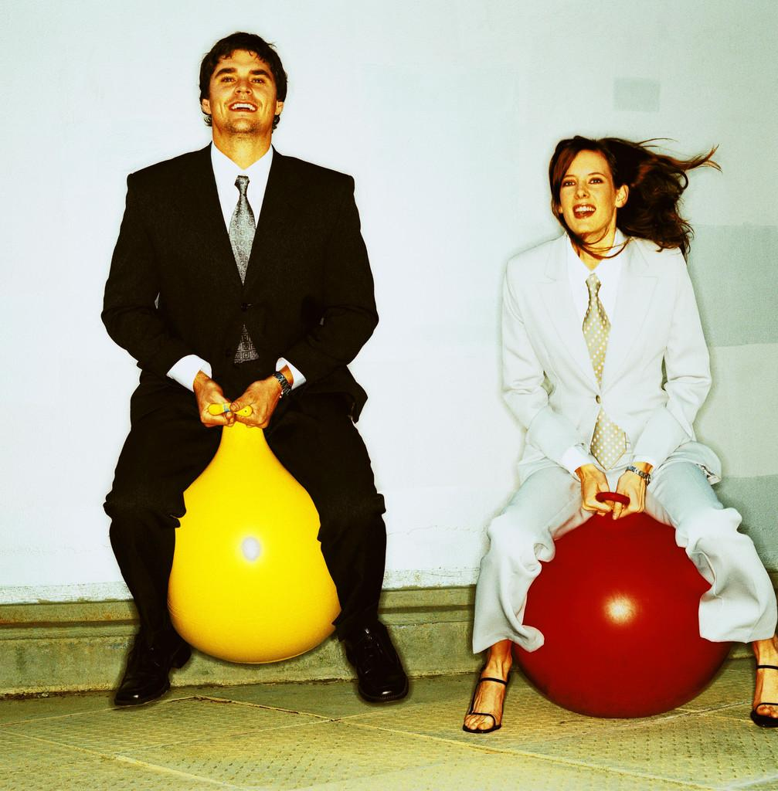
Adult Nutrition

Slide 2
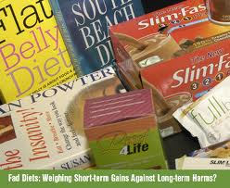
Adult Nutrition
Every day, Americans are inundated with health messages from the media, health professionals, and well-intentioned acquaintances. Most consumers are aware of the seemingly endless array of concerns associated with lifestyle and diet, and the implied promise of good health and extended life via the magic bullet of the moment.

Slide 3
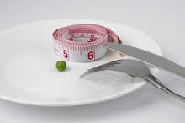
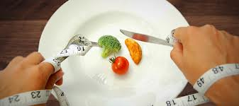
Decisions, Decisions: We need to Make Choices We Can Live With
The fact is that Americans have choices—lots of choices. A healthy lifestyle is not defined solely by the food on—or not on—one’s plate.

Slide 5
Dietary Guidelines 2010
The Dietary guidelines for Americans is a set of guidelines that the USDA produces every 5 years to encourage healthy lifestyles.

Slide 6
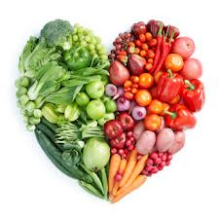
Dietary Guidelines 2010
Eat nutrient dense foods
- Foods that have a lot of vitamins, minerals or other important nutrients and few calories are considered nutrient dense

Slide 7
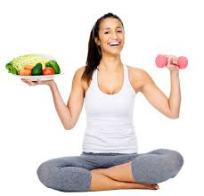
Dietary Guidelines 2010
2. Balance Calories to manage weight

Slide 8
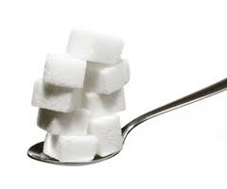
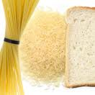
Dietary Guidelines 2010
3. Reduce sodium, fats and added sugars, refined grains and alcohol.

Slide 9
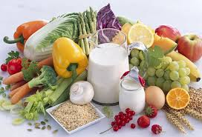
Dietary Guidelines 2010
4. Increase vegetables, fruits, whole grains, milk, seafood and use oils in place of solid fats.

Slide 10
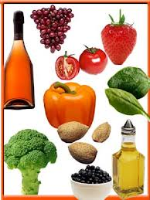
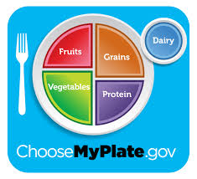
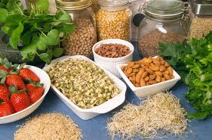
Dietary Guidelines 2010
5. Build healthy eating patterns that meet nutritional needs over time at an appropriate calorie level.

Slide 11
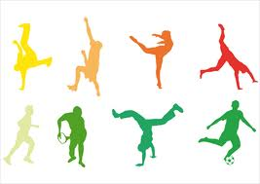
Dietary Guidelines 2010
6. Include Physical Activity as part of a healthy lifestyle

Slide 12
Adult Nutrition
Be Flexible: Go ahead and balance what you eat and the physical activity you do over several days. No need to worry about just one meal or one day.
Be Sensible: Enjoy all foods, just don’t overdo it.
Be Active: Walk the dog, don’t just watch the dog walk.
It’s All About You: Relating the Dietary Guidelines to American Life
Be Realistic: Make small changes over time in what you eat and the level of activity you do. After all, small steps work better than giant leaps.
Be Adventurous: Expand your tastes to enjoy a variety of foods.

Slide 13
Adult Nutrition
Metabolism slows down; generally total food intake needs to be reduced.
Exercise is an important component to balancing food intake and output.
Sedentary lifestyle creates a greater need for daily exercise.

Slide 14
“Feel better today. Stay healthy for tomorrow.”
Make smart choices from every food group.
Find your balance between food and physical activity.
Get the most nutrition out of your calories.

